Slide 2
Ethical aspects and recommendations on ATI during HIV remission trials
Nir Eyal
Share your thoughts on this presentation with #IAS2019

Slide 3
Disclosure: Nir Eyal
I have no relevant personal/professional/financial relationship(s)
with respect to this educational activity.
Henry Rutgers Professor of Bioethics
Rutgers University
This work was funded by NIAID R01 AI114617-01A1.

Slide 4
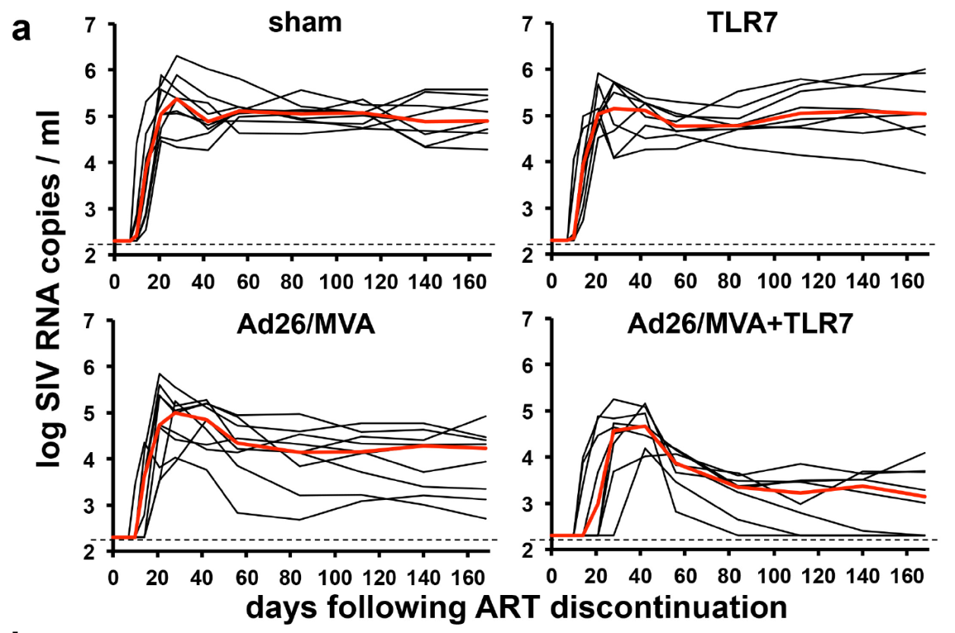
HIV remission studies with ATI are risky for both participants and sexual partners
Borducchi EN et al, 2016
Ad26/MVA prime-boost vaccine with a TLR7 agonist controlled viremia during an interruption with 3/9 exhibiting “complete” control.
Control was apparent only after a period of high-level viremia that lasted weeks.
Eyal N & Deeks SG. Risk to Nonparticipants in HIV Remission Studies with Treatment Interruption: A Symposium. J of Infect Dis, 2019 August 1; 220(Supp. 1).

Slide 5
HIV remission studies with ATI are risky for both participants and sexual partners
Risk to active/control participants (=acute retroviral syndrome; selection of drug-resistant HIV; immunodeficiency and irreversible harm to immune system; reseeding of reservoir) is serious, but usually:
Known to researchers and in that respect somewhat manageable;
Something that candidate participants can consent to with relative comprehension (compared to e.g. toxicity from unfamiliar drugs);
Like other challenges in research ethics.
Risk to seronegative sex partners (=HIV infection):
In the case of unstable sexual relationships--often unknown to researchers—the infection might remain untreated!
Not something that participants’ consent justifies.
Not what research ethics/regulation is classically about.

Slide 6
At least one partner in stable relationship was infected
Lelièvre JD, Hocqueloux L. Unintended HIV-1 Transmission to a Sex Partner in a Study of a Therapeutic Vaccine Candidate, J of Infect Dis, 2019 August 1; 220(Supp. 1).
How many partners in unstable relationships have been infected in such trials, and may remain untreated?

Slide 7
BTW additional studies risk infecting nonparticipants eg
Challenge studies (Shah et al, Science 2018)
HIV treatment-as-prevention trials (Bärnighausen, Clin Trials forthcoming 2019)
Xenotransplantation studies (Barker & Polcrack, Med Health Care Philos 2001)
Gain of function studies without human participants (Evans, Lipsitch & Levinson, JME 2015)

Slide 8
David Cutler, PNAS
Eyal et al. Opinion: Risk to study nonparticipants: A procedural approach. Proc Natl Acad Sci. 2018 Aug 7;115(32).

Slide 9
What is ethically owed to sex partners in HIV remission studies with an ATI?
Unclear, partly because a philosophical theory of what is ethically owed to nonparticipants at risk from research is currently lacking.
Until such a theory emerges, I propose a low-hanging fruit approach:
If a measure affords substantial protections to nonparticipants, costs little time, effort, and money, and involves no independent major transgressions (e.g. of participants’ confidentiality), then mandate it for now.

Slide 10
Ways to reduce/justify risk of infecting partners in studies with ATI
During recruitment
Special exclusion criteria
Candidate participant’s reported high setpoint, unsafe sex habits, opposition to protective measures below. (Compare: history of cutaneous Kaposi sarcoma).
Uninfected partner’s reported opposition to PrEP, condoms and if needed, ART; multiple partners.
Disclosure of protective measures and their limitations to participants.
Consent rights to any reported partners in stable sexual relationships.
Trial operations
Frequent participant counsel on safe sex.
Restarting preparedness: Frequent VL monitoring, clear guidelines on when to restart ART.
Not: Isolation.
Moderately limiting placebo.

Slide 11
Ways to reduce/justify risk of infecting partners in studies with ATI
Protective care for nonparticipants at risk
Providing counselling and PrEP to reported partners.
Not: Designating partners as study participants.
Measures to reduce harm from infection
Some treatment support.
Limiting conflicts of interest, commercial sponsors.

Slide 12
A glitch: Protecting non-participants is not legally IRBs’ job
“…this policy applies to all research involving human subjects conducted, supported or otherwise subject to regulation by any federal…” (45 CFR § 46.101(a))
“According to the FDA definition of an IRB, "The primary purpose of [IRB] review is to assure the protection of the rights and welfare of the human subjects.” (21 CFR 56.102(g))

Slide 13
To conclude
How much protection is owed nonparticipants remains a very open question.
So in HIV remission studies that include an ATI, I recommend a low-hanging fruit approach to addressing risk to sex partners. Those pertain to recruitment, trial operations, protective care for partners, and measures to reduce harm from any infection, and differ somewhat from current practices.
An ethical and legal framework is needed to govern this area. Currently—quite absurdly in my view—US law does not mandate IRBs to expect researchers to protect sexual partners from HIV infection.

Slide 14
Read more
Eyal N. How to Address the Risk of HIV Transmission in Remission Studies With Treatment Interruption: The Low-Hanging Fruit Approach. J Infect Dis 2019;220(Supplement 1).
Eyal N, Holtzman LG, Deeks S. Ethical issues in HIV remission trials. Curr Opin HIV AIDS 2018;13(5).
Julg B, Dee L, Ananworanich J, et al. Recommendations for analytical antiretroviral treatment interruptions in HIV research trials—report of a consensus meeting. Lancet HIV 2019;6.

Slide 15
Read more: Two new symposia on ATI risk to nonparticipants
Risk to sexual partners in HIV remission studies with treatment interruption.
J Infect Dis 2019;220(Supp. 1).
Contributors: SG Deeks, N Eyal, J-D Lelièvre, L Hocquelloux, L Dawson, M Magalhaes, DM Margolis.
Risk to bystanders in clinical trials.
Clin Trials forthcoming 2019.
Contributors: T Barnighausen, IG Cohen, N Eyal, A Fairchild, J Haberer, L Holtzman, J Kimmelman, P Krezanoski, M Lipsitch, G Vong, D Wikler.

Slide 16
Thank you
Questions?

